Slide 1

INSTRUCTOR
Dr. Adel Abusitta
A STUDY ABOUT
Diabetes Disease Prediction using Machine
Learning on Big Data of Healthcare
STATISTICAL LEARNING PROJECT
Shashank Kannan – 110122650
Dixit Nandaniya: 110122302
V.01
UNIVERSITY OF WINDSOR / DEPARTMENT OF COMPUTER SCIENCE

Slide 2

Introduction
Machine Learning for disease diagnosis and decision making
Diabetes prediction model with seven algorithms
SVM and CART best predictor with the highest accuracy
Big Data Analytics for healthcare data
Treatment trends analysis for healthcare quality
The Naive Bayes,
Support Vector Machine,
Random Forest,
Simple CART
Logistic regression
CATboost
XGboost
01
UNIVERSITY OF WINDSOR / Department of cOMPUTER SCIENCE

Slide 3
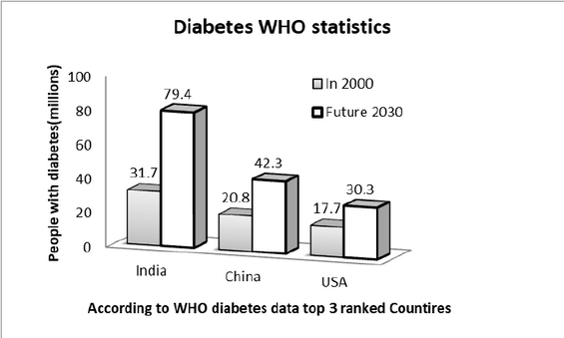
Diabetes is the fifth deadliest disease worldwide, with India having the highest number of patients
This paper compares seven supermachine learning algorithms to recommend the best approach for accurate diabetes prediction
02
UNIVERSITY OF WINDSOR / DEPARTMENT OF COMPUTER SCIENCE

Slide 4
Problem statement
Diabetes is a chronic disease that affects the body’s ability to regulate blood sugar and can cause serious complications
Machine learning can help predict diabetes and provide automated diagnosis under the validation of a professional doctor
Machine learning can discover interesting patterns in disease data and improve diagnosis and prognosis
Objective
The objective of our project is to use machine learning and big data to accurately predict diabetes and provide automated diagnosis under the validation of a professional doctor. We aim to compare the performance of several machine learning models and recommend the best algorithm for predicting diabetes based on efficient performance results.
03
UNIVERSITY OF WINDSOR / Department of cOMPUTER SCIENCE

Slide 5

Dataset: Pima Indians Diabetes Database from National Institute of Diabetes and Digestive and Kidney Diseases
Instances: 768 (268 positive, 500 negative)
Attributes: 9 (8 numeric, 1 nominal)
Sr No. | Attribute Used | Attribute Type | Attribute Description
1 | preg | Numeric | No. of times pregnant
2 | plas | Numeric | Plasma glucose concentration a 2 hours in an oral glucose tolerance test
3 | pres | Numeric | Diastolic blood pressure (mm Hg)
4 | skin | Numeric | Triceps skin fold thickness (mm)
5 | insu | Numeric | 2-Hour serum insulin (mu U/ml)
6 | mass | Numeric | Body mass index (weight in kg / (height in square m)
7 | pedi | Numeric | Diabetes pedigree function
8 | age | Numeric | Age (years)
9 | Class | Nominal | Class variable (tested positive or tested negative)
04
UNIVERSITY OF WINDSOR / DEPARTMENT OF COMPUTER SCIENCE

Slide 6
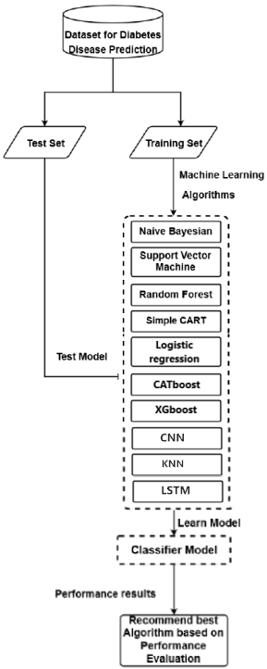

Flowchart
05
UNIVERSITY OF WINDSOR / Department of cOMPUTER SCIENCE

Slide 7

Model Descriptions
In our study, we compared the performance of several machine learning models for predicting diabetes using big data in healthcare.
06
UNIVERSITY OF WINDSOR / Department of cOMPUTER SCIENCE

Slide 8

01
Fully Connected Neural Network
A Fully Connected Neural Network, also known as a Multi-Layer Perceptron (MLP), is a type of artificial neural network. It consists of layers of interconnected nodes (neurons) that process input data through weighted connections. Each node applies an activation function to the weighted sum of its inputs, transforming the data and learning complex patterns in the process. In this scenario, the model processes the scaled diabetes dataset to learn relationships between input features and the diabetes outcome, aiming to make accurate predictions.
07
UNIVERSITY OF WINDSOR / DEPARTMENT OF COMPUTER SCIENCE

Slide 9

02
Long Short-Term Memory (LSTM)
Long Short-Term Memory is a type of recurrent neural network (RNN) designed for sequence data, like time series or text. Unlike traditional feedforward neural networks, LSTM includes memory cells and gates to capture long-term dependencies and avoid the vanishing gradient problem. In this scenario, LSTM processes the diabetes data as sequential data, learning temporal patterns that might contribute to diabetes outcomes.
08
UNIVERSITY OF WINDSOR / DEPARTMENT OF COMPUTER SCIENCE

Slide 10

03
K-Nearest Neighbors (KNN)
K-Nearest Neighbors is a simple classification algorithm that assigns a data point to the class most common among its k nearest neighbors. It measures the proximity between data points using distance metrics like Euclidean distance. In this case, the KNN model classifies diabetes outcomes based on the characteristics of similar data points in the training set.
09
UNIVERSITY OF WINDSOR / DEPARTMENT OF COMPUTER SCIENCE

Slide 11

04
Logistic Regression
Logistic Regression is a statistical model used for binary classification. Despite its name, it's used for classification tasks. The model estimates the probability of a binary outcome using a logistic function, which maps input features to the probability of belonging to a certain class. In this scenario, logistic regression learns the relationships between features and diabetes outcomes to predict whether an individual has diabetes or not.
10
UNIVERSITY OF WINDSOR / DEPARTMENT OF COMPUTER SCIENCE

Slide 12
05
Support Vector Machine (SVM)
A Support Vector Machine is a powerful classification algorithm that aims to find the optimal hyperplane that best separates data points of different classes. It does so by maximizing the margin between classes while minimizing misclassifications. In this case, SVM tries to find the hyperplane that best separates individuals with diabetes from those without, based on the input features.
11
UNIVERSITY OF WINDSOR / DEPARTMENT OF COMPUTER SCIENCE

Slide 13
06
Random Forest Classification
Random Forest is an ensemble learning technique that builds multiple decision trees and combines their outputs for better accuracy and robustness. Each tree is trained on a subset of data with bootstrapping, and the model aggregates the predictions of individual trees. In this scenario, the Random Forest model constructs multiple decision trees to collectively predict diabetes outcomes based on various feature combinations.
12
UNIVERSITY OF WINDSOR / DEPARTMENT OF COMPUTER SCIENCE

Slide 14

07
Naive Bayes Classification
Naive Bayes is a probabilistic classification method based on Bayes' theorem. It assumes that features are conditionally independent given the class, simplifying computations. Despite its "naive" assumption, Naive Bayes performs well in practice, especially with text and categorical data. In this scenario, Naive Bayes calculates the probability of an individual having diabetes based on the probabilities of feature occurrences in each class.
13
UNIVERSITY OF WINDSOR / DEPARTMENT OF COMPUTER SCIENCE

Slide 15
08
Simple CART Classifier
A Decision Tree is a flowchart-like structure where each internal node represents a feature, each branch represents a decision rule, and each leaf node represents an outcome. The Simple CART model creates a binary tree where decisions are made at each node based on specific feature conditions. In this case, the Decision Tree is used to classify diabetes outcomes by traversing the tree based on input features.
13
UNIVERSITY OF WINDSOR / DEPARTMENT OF COMPUTER SCIENCE

Slide 16
09
XGBoost
XGBoost (Extreme Gradient Boosting) is an advanced gradient boosting algorithm that combines multiple decision trees sequentially. It addresses shortcomings of traditional boosting, such as overfitting, by incorporating regularization and optimizing the model's hyperparameters. In this scenario, XGBoost constructs an ensemble of decision trees to predict diabetes outcomes while minimizing bias and variance.
13
UNIVERSITY OF WINDSOR / DEPARTMENT OF COMPUTER SCIENCE

Slide 17
10
CatBoost
CatBoost stands for "Categorical Boosting" and is a gradient-boosting algorithm specifically designed to handle categorical features effectively. It uses an ordered boosting technique and employs various strategies to process categorical data. In this case, CatBoost constructs an ensemble of decision trees to predict diabetes outcomes, taking into account the unique properties of categorical features in the dataset.
13
UNIVERSITY OF WINDSOR / DEPARTMENT OF COMPUTER SCIENCE

Slide 18
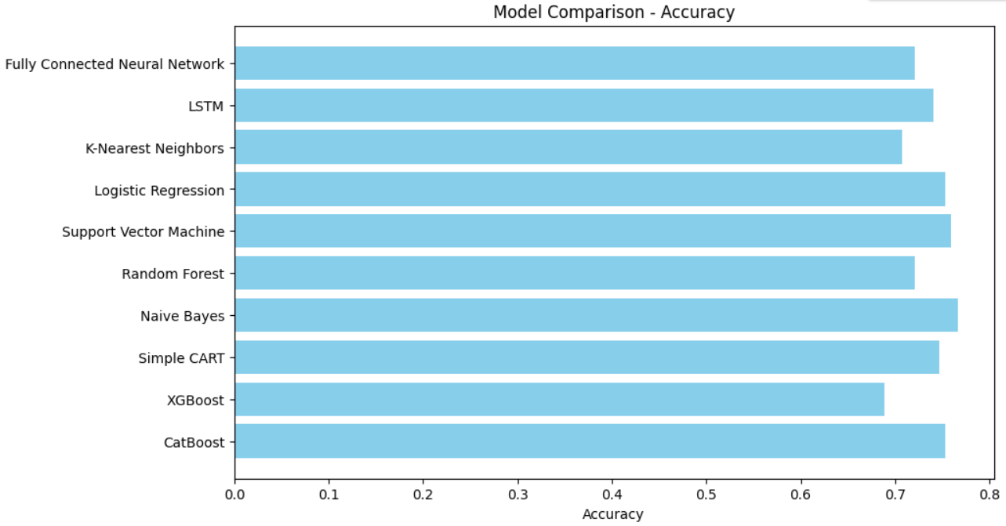
Accuracy
The accuracy ranges from a lowest of 68.83% (XGBoost) to a highest of 76.62% (Naive Bayes) among the models tested.
14
UNIVERSITY OF WINDSOR / DEPARTMENT OF COMPUTER SCIENCE

Slide 19
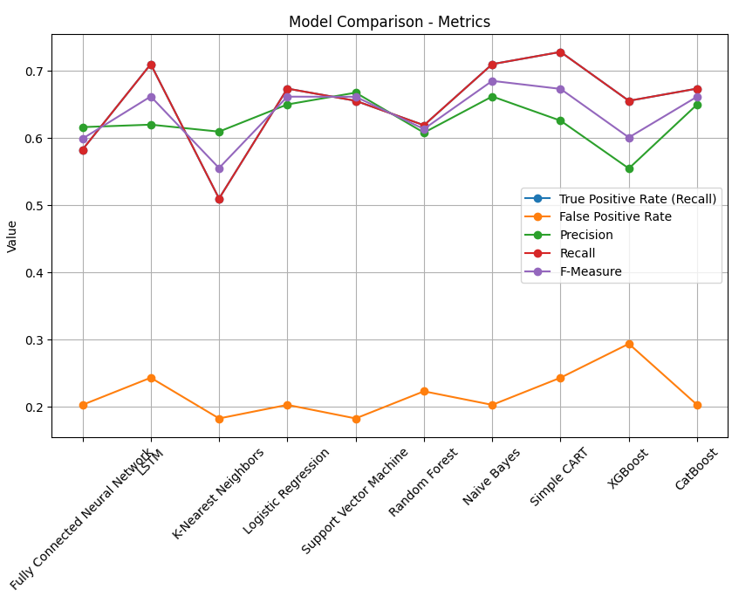
Parameters
True Positive Rate (Recall): Simple CART achieved the highest recall rate of 72.73%, while K-Nearest Neighbors had the lowest at 50.91%.
False Positive Rate: Support Vector Machine showcased the lowest false positive rate at 18.18%, while XGBoost had the highest at 29.29%.
Precision: Support Vector Machine demonstrated the highest precision at 66.67%, while XGBoost had the lowest at 55.38%.
F-Measure: Naive Bayes attained the highest F-measure at 68.42%, and K-Nearest Neighbors achieved the lowest at 55.45%.
15
UNIVERSITY OF WINDSOR / DEPARTMENT OF COMPUTER SCIENCE

Slide 20

CONCLUSIUON
Overall, our study provides valuable insights into the performance of different machine learning models for predicting diabetes using big data in healthcare. Further research could explore ways to improve the accuracy and efficiency of these models.
17
UNIVERSITY OF WINDSOR / DEPARTMENT OF COMPUTER SCIENCE

Slide 21
thank you!
FOR YOUR TIME
V.01
UNIVERSITY OF WINDSOR / DEPARTMENT OF COMPUTER SCIENCE

